Slide 1


Data Analysis with Microsoft Excel

Slide 2





Advanced Excel Features
Lecture 2: Output
Conditional Formatting
Advanced Filtering
Essential Forms and Formulas
Text Functions
Conditional Statements
www.dsa.az Bütün hüquqlar qorunur.
DATA SCIENCE ACADEMY
2

Slide 3


I
Advanced Excel Features

Slide 4
Advanced Excel Features
Conditional Formatting
Advanced Filtering
www.dsa.az Bütün hüquqlar qorunur.
DATA SCIENCE ACADEMY
4

Slide 5
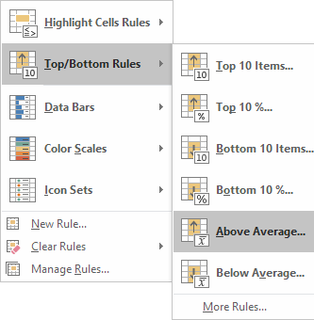
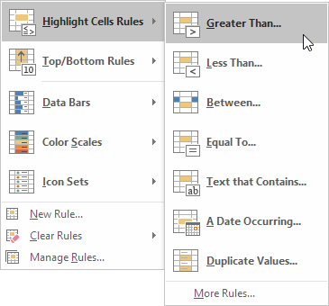
Conditional Formatting
by cell rules
by Top/Bottom rules
Formats the cells based on fixed values
(if data is changed, these values will not change)
Formats the cells based on variables
(if the data is changed these values can change)
www.dsa.az Bütün hüquqlar qorunur.
DATA SCIENCE ACADEMY
5

Slide 6
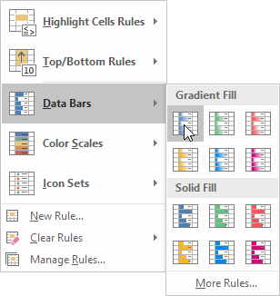
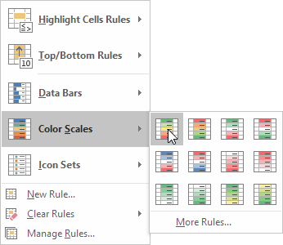
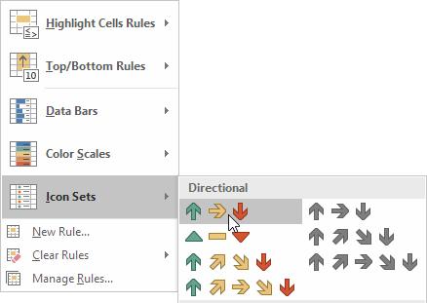

Conditional Formatting
Data Bars
Color Scales
Icon Sets
Colors the cells based on their values. According to the value of the cell, the length of bar is changing.
Colors the cells based on their values. According to the value of the cell, the color of it is changing.
Colors the cells based on their values. According to the value of the cell, the icon is changing.
www.dsa.az Bütün hüquqlar qorunur.
DATA SCIENCE ACADEMY
6

Slide 7
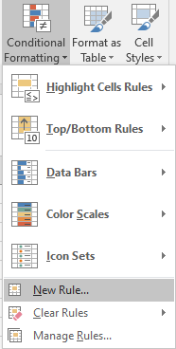
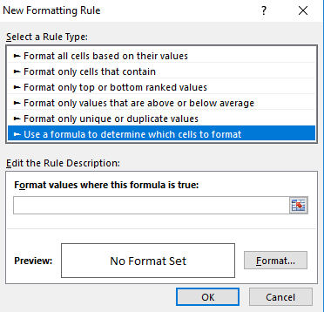

Conditional Formatting-More Rules
More options for each criteria
Formula based formatting
Type any formula and give your own formatting.
Depends on your creativity and data analysis requirements
www.dsa.az Bütün hüquqlar qorunur.
DATA SCIENCE ACADEMY
7

Slide 8
Conditional Formatting
Example formula-based formatting tasks:
Fill a cell with green where product is “Bike”
Highlight cells with blue where sales is more than $ 9 000.00
Change Sales Person’s (who made more than 9000 USD) names color to bold green
Higher units, darker the cell
Fill (gradually) a cell with color based on its value, higher sales amount, more filled is the cell (horizontally)
www.dsa.az Bütün hüquqlar qorunur.
DATA SCIENCE ACADEMY
8

Slide 9
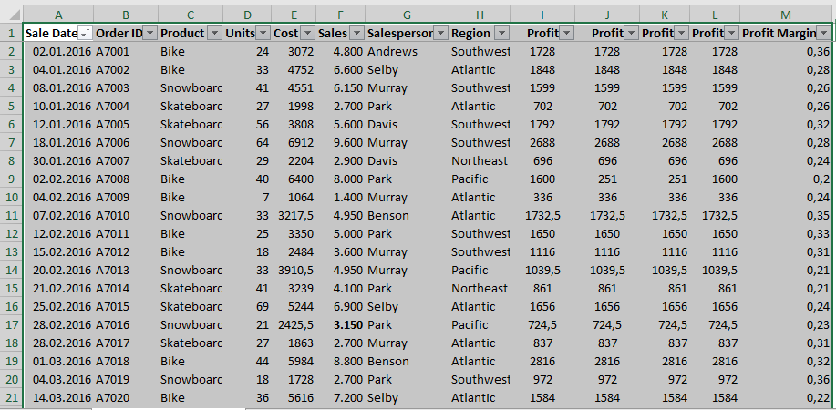
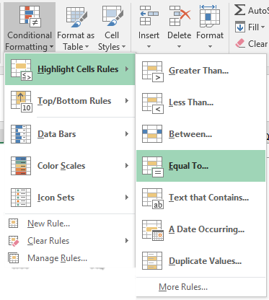
Conditional Formatting
Task: Fill a cell with red where product is “Bike”
Open “Advanced features.xlsx” and go to “Conditional Formatting” sheet.
Select the data that you want to format.
Go to Conditional formatting section in Home tab and select “Equal To…” from Highlight Cell Rules.
1
2
www.dsa.az Bütün hüquqlar qorunur.
DATA SCIENCE ACADEMY
9

Slide 10
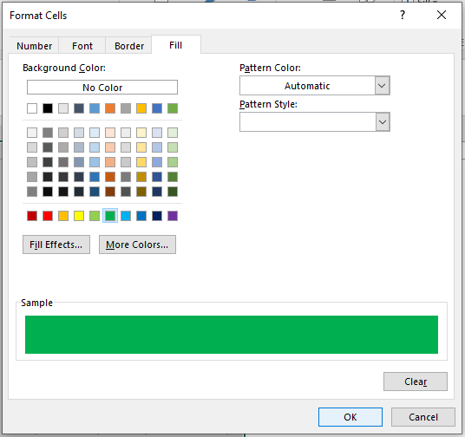
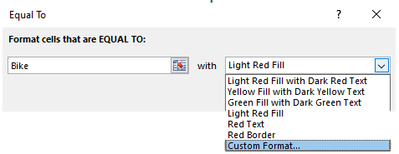
Conditional Formatting
Write “Bike” to “Format cells that are EQUAL TO:” section and choose “Custom Format” in the right side.
In the new window select green color in the Fill section.
Click “OK”.
4
3
www.dsa.az Bütün hüquqlar qorunur.
DATA SCIENCE ACADEMY
10

Slide 11
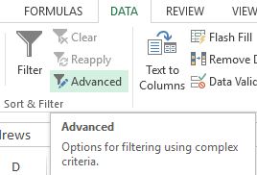
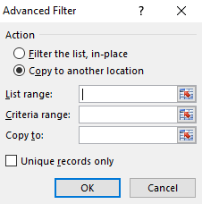
Advanced Filtering
Advanced Filtering, filters all the data based on a criteria, and all the data which fits for the criteria is shown as output.
List range: source of the data
Criteria range: source of the criteria
Copy to: anywhere you want to copy results
www.dsa.az Bütün hüquqlar qorunur.
DATA SCIENCE ACADEMY
11

Slide 12


Advanced Filtering - Criteria Range
in criteria range, column name should be the same with the data.
copy column names that you want to filter to the destination, then apply advanced filter
www.dsa.az Bütün hüquqlar qorunur.
DATA SCIENCE ACADEMY
12

Slide 13
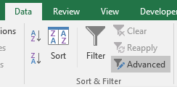
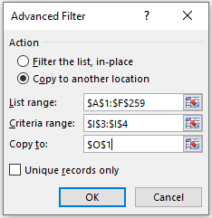
Advanced filtering
Filter the data by using “Advanced Filtering”, and find the amounts which are greater than 100000
Open “Advanced features.xlsx” and go to “Advanced Filtering” sheet.
Go to Data tab and select Advanced in “Sort & Filter” section.
Choose “Copy to another location”
Select all data in “List Range” section.
Select the criteria that you want to filter in “Criteria range” section.
Choose a cell that you want to export the filtered data in “Copy to” section.
1
2
www.dsa.az Bütün hüquqlar qorunur.
DATA SCIENCE ACADEMY
13

Slide 14
II
Essentional Forms and Formulas

Slide 15
Essential Excel Forms and formulas
Text Functions
Conditional Statements
www.dsa.az Bütün hüquqlar qorunur.
DATA SCIENCE ACADEMY
15

Slide 16
Text Functions
LEFT returns the first character or characters in a text string, based on the number of characters you specify
LEFT(text, [num_chars])
text - The text string that contains the characters you want to extract.
num_chars - Specifies the number of characters you want LEFT to extract.
RIGHT returns the last character or characters in a text string, based on the number of characters you specify.
RIGHT(text,[num_chars])
text - The text string that contains the characters you want to extract.
num_chars - Specifies the number of characters you want RIGHT to extract.
www.dsa.az Bütün hüquqlar qorunur.
DATA SCIENCE ACADEMY
16

Slide 17
Text Functions
MID returns a specific number of characters from a text string, starting at the position you specify, based on the number of characters you specify.
MID(text, start_num, num_chars)
text - The text string containing the characters you want to extract.
start_num - The position of the first character you want to extract in text. The first character in text has start_num 1, and so on.
num_chars - Specifies the number of characters you want to extract.
LEN returns the number of characters in a text string.
LEN(text)
text - The text whose length you want to find. Spaces count as characters.
www.dsa.az Bütün hüquqlar qorunur.
DATA SCIENCE ACADEMY
17

Slide 18
Text Functions
CONCATENATE, one of the text functions, to join two or more text strings into one string.
CONCATENATE(text1, [text2], ...)
Text1 - The first item to join. The item can be a text value, number, or cell reference.
Text2, ... - Additional text items to join. You can have up to 255 items, up to a total of 8,192 characters.
& (Ampersand) - to make a single string out of two or more text strings.
PROPER function sets the first character in each word to uppercase and the rest to lowercase.
PROPER(text)
Text - Text enclosed in quotation marks, a formula that returns text, or a reference to a cell containing the text you want to partially capitalize.
www.dsa.az Bütün hüquqlar qorunur.
DATA SCIENCE ACADEMY
18

Slide 19
Text Functions
TRIM function Remove extra spaces from text.
TRIM (text)
Text - The text from which to remove extra space.
UPPER function returns an upper-case version of a given text string.
UPPER (text)
Text - The text that to convert to upper case.
LOWER function returns a lower-case version of a given text string.
LOWER(text)
Text - The text you want to convert to lowercase. LOWER does not change characters in text
that are not letters.
www.dsa.az Bütün hüquqlar qorunur.
DATA SCIENCE ACADEMY
19

Slide 20
Conditional Statements
AND function, one of the logical functions, to determine if all conditions in a test are TRUE.
AND (logical1, [logical2], ...)
logical1 - The first condition or logical value to evaluate.
logical2 - [optional] The second condition or logical value to evaluate.
OR tests multiple conditions TRUE if any arguments evaluate TRUE; FALSE if not.
OR (logical1, [logical2], ...)
logical1 - The first condition or logical value to evaluate.
logical2 - [optional] The second condition or logical value to evaluate.
www.dsa.az Bütün hüquqlar qorunur.
DATA SCIENCE ACADEMY
20

Slide 21
Conditional Statements
IF function tests for a specific condition. Test for a specific condition.
IF (logical_test, [value_if_true], [value_if_false])
logical_test - A value or logical expression that can be evaluated as TRUE or FALSE.
value_if_true - The value to return when logical_test evaluates to TRUE.
value_if_false - The value to return when logical_test evaluates to FALSE.
www.dsa.az Bütün hüquqlar qorunur.
DATA SCIENCE ACADEMY
21

Slide 22
Conditional Statements
SUMIFS function sums cells that match multiple criteria.
SUMIFS (sum_range, range1, criteria1, [range2], [criteria2], ...)
sum_range - The range to be summed.
range1 - The first range to evaluate.
criteria1 - The criteria to use on range1.
range2 - The second range to evaluate.
criteria2 - The criteria to use on range2.
COUNTIFS counts cells that match multiple criteria.
COUNTIFS (range1, criteria1, [range2], [criteria2], ...)
range1 - The first range to evaluate.
criteria1 - The criteria to use on range1.
range2 - The second range to evaluate.
criteria2 - The criteria to use on range2.
www.dsa.az Bütün hüquqlar qorunur.
DATA SCIENCE ACADEMY
22

Slide 23
Thank you!

